Slide 1
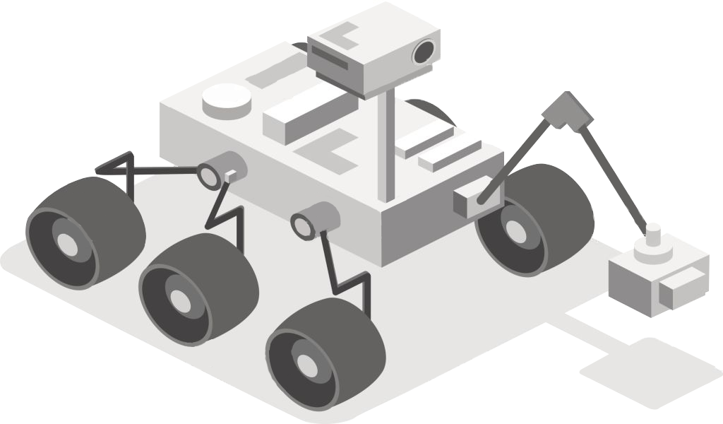
Mars Rover
Autonomous Navigation
Client: Osama Alshaykh
Linden Vo, Tommy Lam, SeungYeun Lee, Daniel Crawley, Brian He
Notes:
https://docs.google.com/presentation/d/1759KthmB_MaOE5sU-b_PL2kIPItLB-Kacp9oyDY4EOo/edit#slide=id.g58e59d3604_0_708

Slide 2
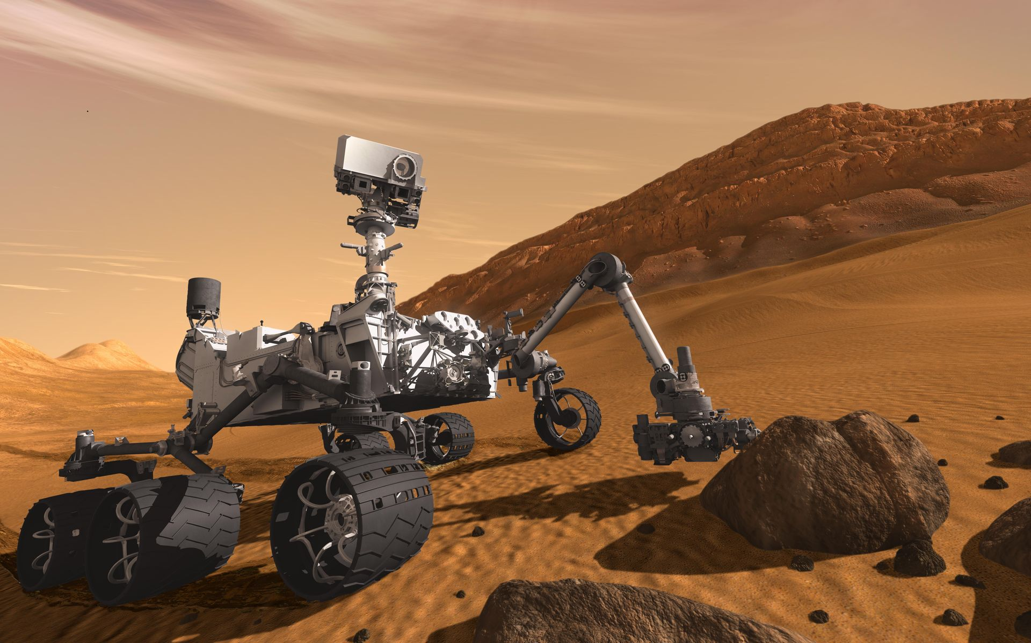
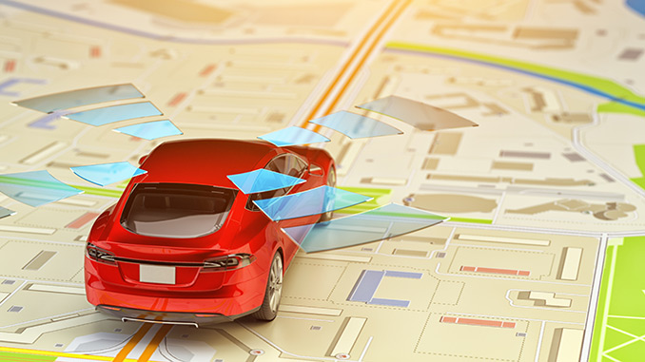
Product Mission Statement
Autonomous Navigation is one of the innovations that provided rapid advancements in many industries
NASA Mars Rover
Automotive Industry
Autonomous Navigation can be used to not only navigate unknown terrain but also improve self-driving vehicles
Notes:
Autonomous Navigation has been one of the major innovation that has provided rapid advancements in many industries.
Specifically for NASA, they use autonomous navigation for Mars Rover, and it is able to autonomously traverse rough terrain and collect data for researchers.
For automotive industry, many companies already have self-driving vehicles that are meant to help reduce risky and dangerous driver behaviors.
Our project was initially defined by autonomous navigation part of NASA’s University Mars Rover Challenge; however, for the purpose of senior design, we worked with the client to re-define some requirements to reach a more attainable goal. Our rover is not suppose to work in Mars but in a similar terrain like Mars.
Our autonomous navigation can be used to not only navigate unknown terrain but also improve self-driving vehicles
-----------------------------------------------------------------------------------------------------------
Our autonomous rover
is not only useful to NASA but also industries such as traditional farming and
food delivery services. For farms, autonomous robots could capture data on yield
and health of crops at the level of individual plants and on a massive scale. For
food delivery, instead of a person delivering the food item, it will be carried to the
customers doorstep on four wheels. With this technology, both industries can see
increased operational efficiency and reduced operating costs.

Slide 3
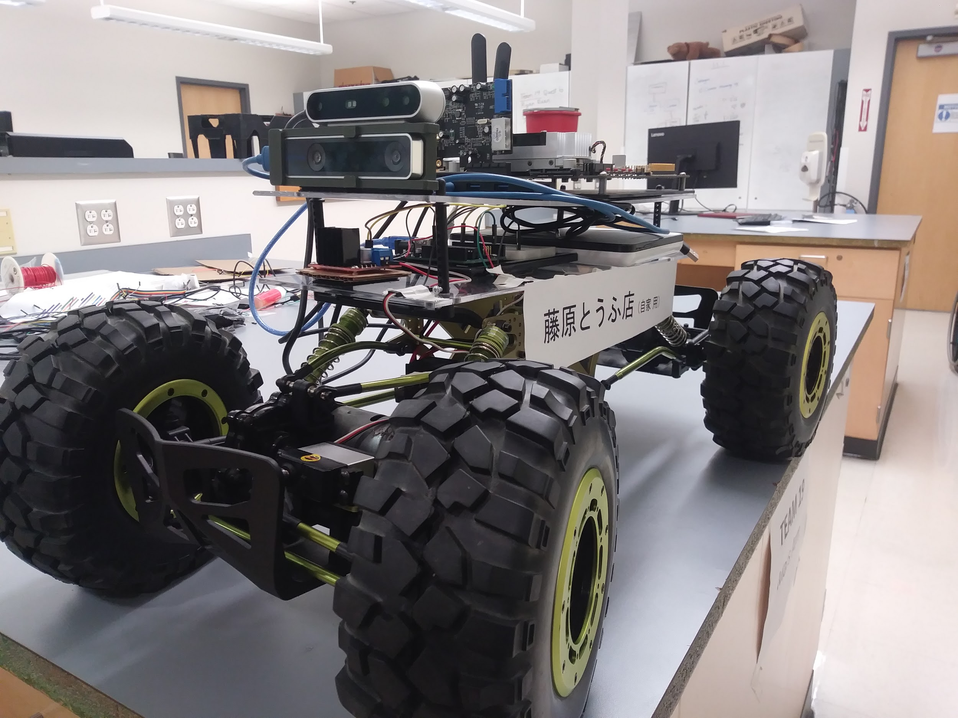
User Stories
Perform simultaneous localization and mapping to find a path to an April Tag
Ability to robustly search for April Tag when not found
Ability to traverse rough terrain and avoid obstacles
Ability to move to a specified GPS coordinate
Note: AprilTag = QR code that acts as a target

Slide 4
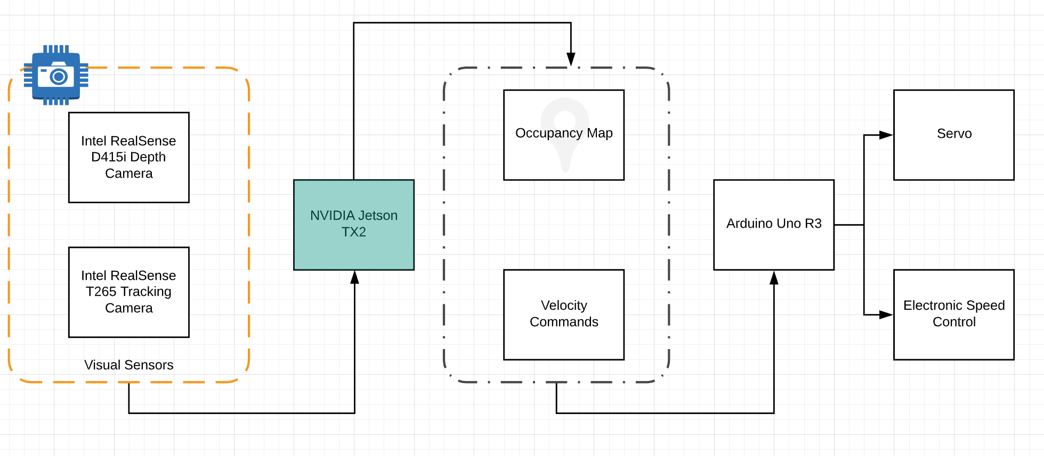
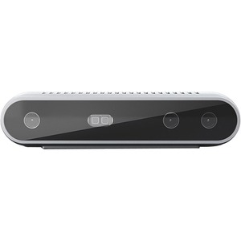
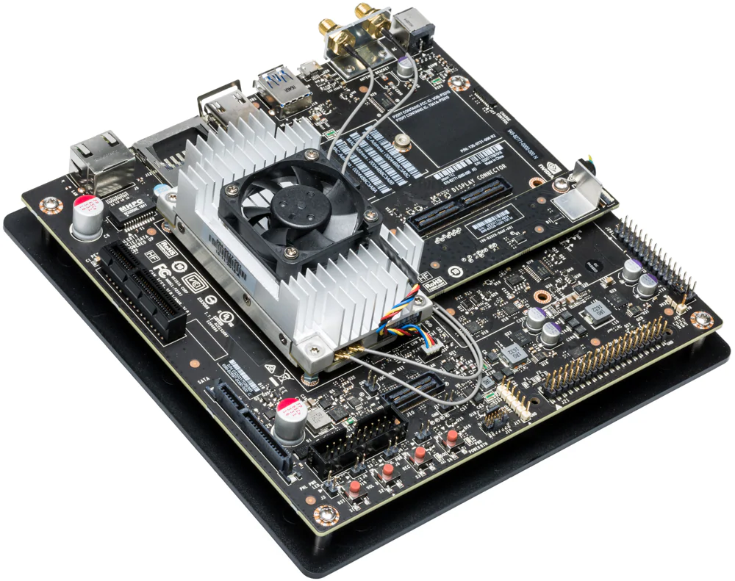
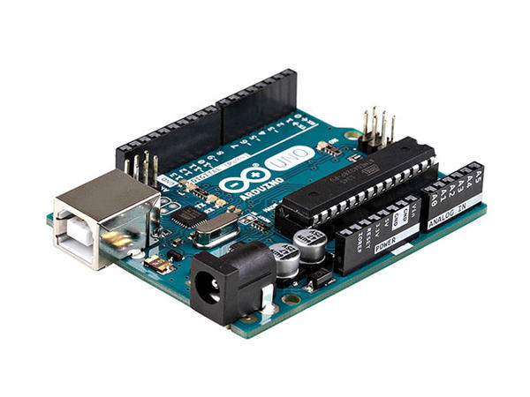
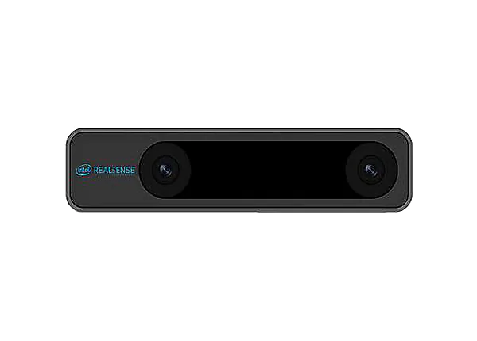
System Overview
Microcontroller
Depth Camera
Onboard Computer
Tracking Camera
Notes:
Overview of system architecture
Our system utilizes the Robot Operating System (ROS) which allows our devices to communicate with each other.
The depth camera and tracking camera sends visual data to our onboard computer which processes it and, based upon the visual data, outputs navigation commands to the arduino which controls the rover’s motors

Slide 5
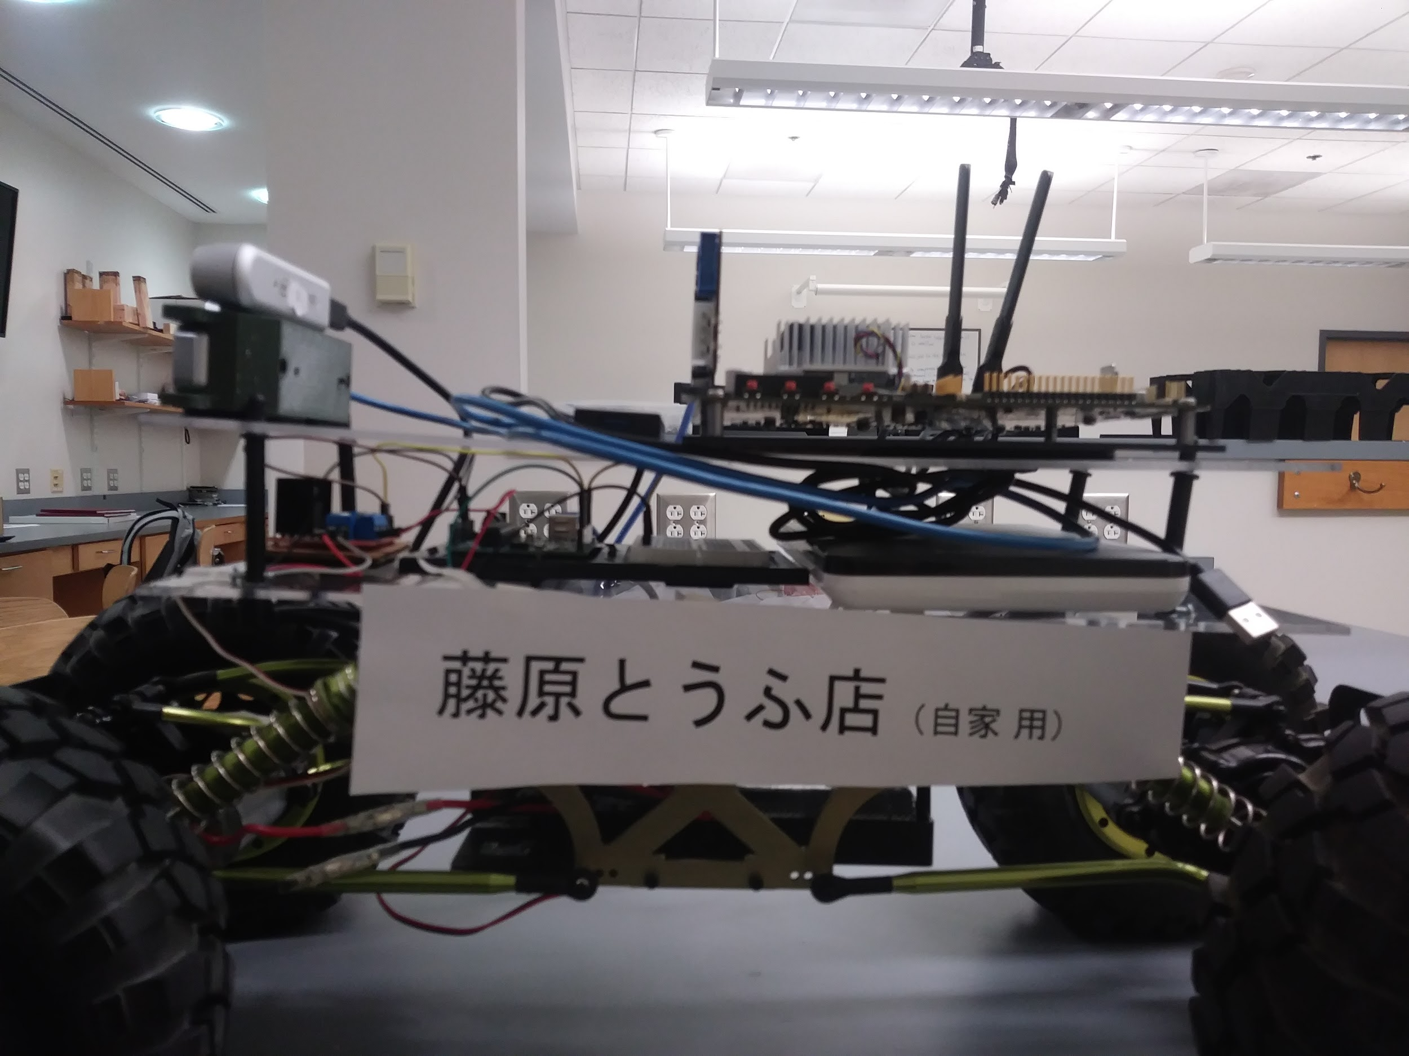
Hardware
D415 Depth Camera
Host Card
Jetson TX2
T265 Tracking Camera
Arduino Uno R3
PowerAdd Pro Battery
L298N Motor Driver
Electronic Speed Control
Car Battery
Notes:
Here is a profile view of our rover.
Our visual data is gathered by the T265 Tracking camera and D415 Depth camera, which are located at the front of the rover and held by a 3D printed mount. They connect to our onboard computer, the Jetson TX2, via USB. The Jetson communicates with the Arduino Uno R3 via a PCIe to USB host card. The Arduino converts this to PWM signals which it sends through the L298N Motor Driver to the Electronic Speed Control and turning servo (behind the front left wheel). The drivetrain and turning components are powered by 7V battery located below the platforms, while the rest of the electronics are powered by the PowerAdd Pro laptop battery. Our chassis is a repurposed RC crawler, which has four wheel-drive and adjustable suspension, allowing us to keep the cameras level for optimal performance.

Slide 6


Software
Our software stack has four layers:
Serial Communication for ESCs for motors and servo control
Node for Intel Realsense cameras receiving video data
Mapping environment in visual interface
Navigation node for obstacle avoidance and PIDs

Slide 7
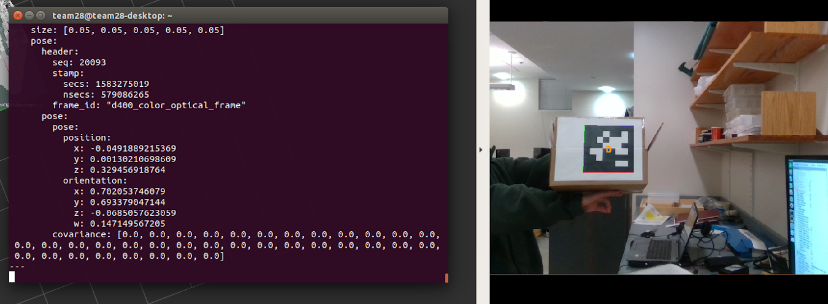
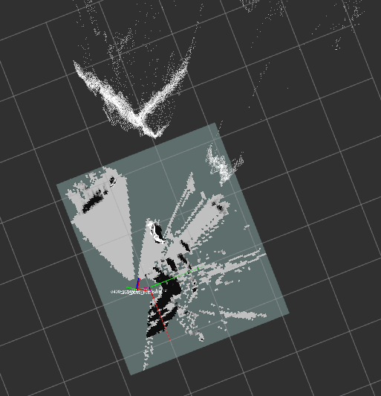
Testing & Results
Able to manually drive rover
Successfully demonstrated acquiring an AprilTag and tracking its coordinates
Navigated towards AprilTag however PID control needed tuning
In the process of developing mapping and obstacle avoidance tests

Slide 8
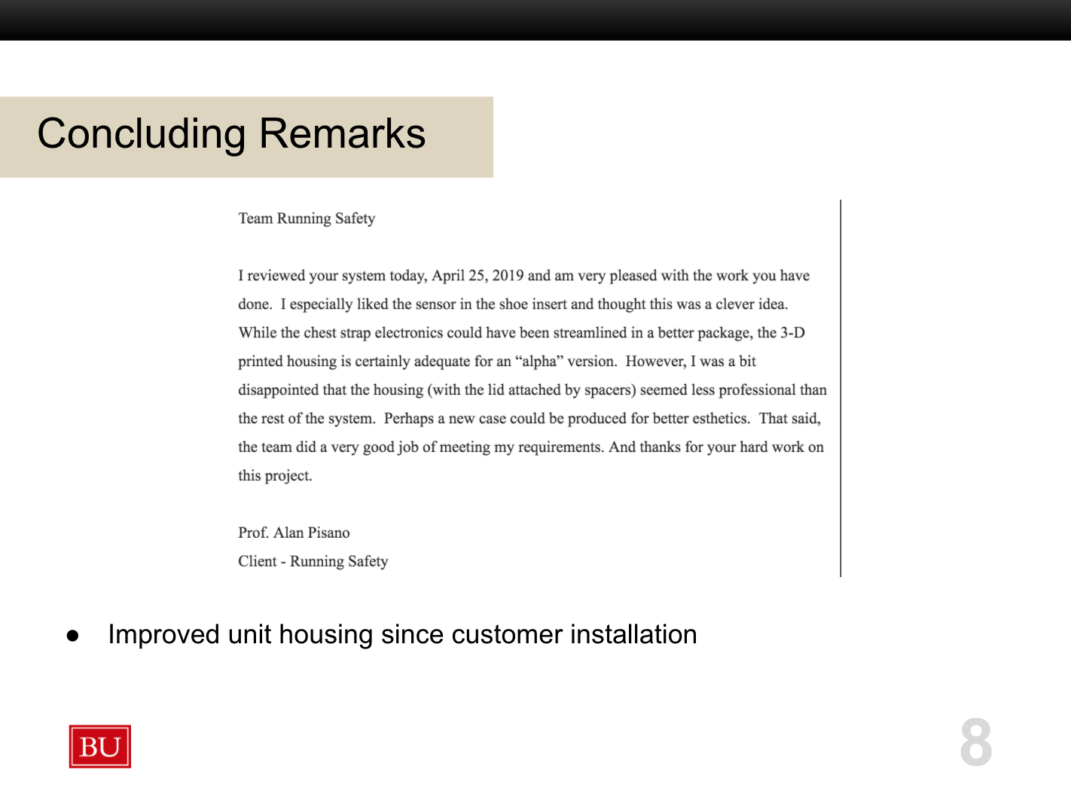
Concluding Remarks-Tommy
Customer feedback

Slide 9
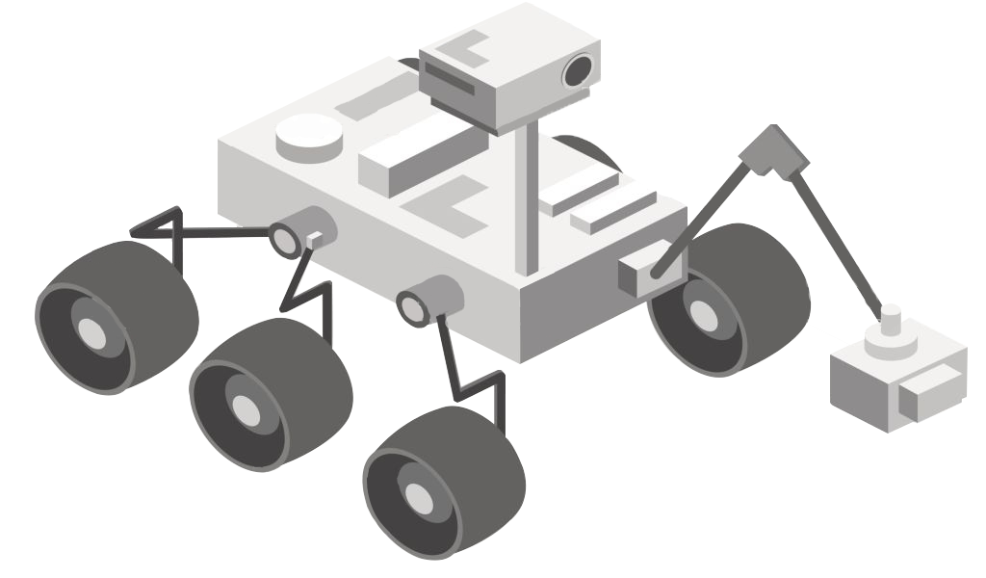
THANKS!
Any questions?

